Slide 1
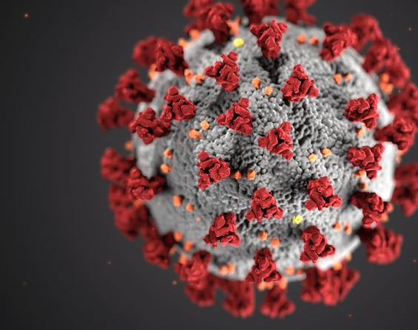
Covid-Predictor (CP) Healthy, Wealthy
Team Members
Fayazuddin, Md – U01031155
Lalith, Banala – U01035260
Rushitha Reddy, Sana – U01032105
Krithi Reddy, Nareddy – U01034369
Manikanta, Rokkam – U01038113
Target Markets: World Health Organization (WHO), USA government (Health Department) and Corporate Individuals

Slide 2
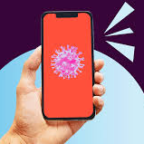

UNIQUE FEATURES
Getting notification about new variant and new location where prevalence will be more.
Notifying subscribed organizations such as Public and Private transportation, schools, restaurants – who will know the status of the spread and can take necessary measures.
This helps the people and organizations to get awareness on the upcoming varaiant which would help them to take all necessary precautions.

Slide 3

Other Features
We are collecting covid-19 data from various sources like WHO, Trusted websites and individuals to develop the application.
We will be using python as a Programming language to develop the application.
Embedding of voice command & control sensors onto the application.
Embedding of GPS onto the app to help in location identification.
Hosting of the app by cloud-based services like MS azure or AWS that guarantees all all-time uptime.

Slide 4

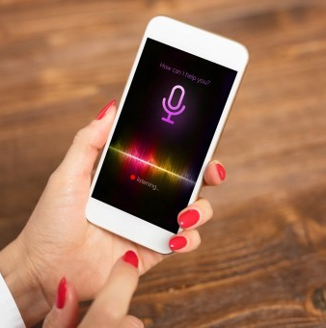
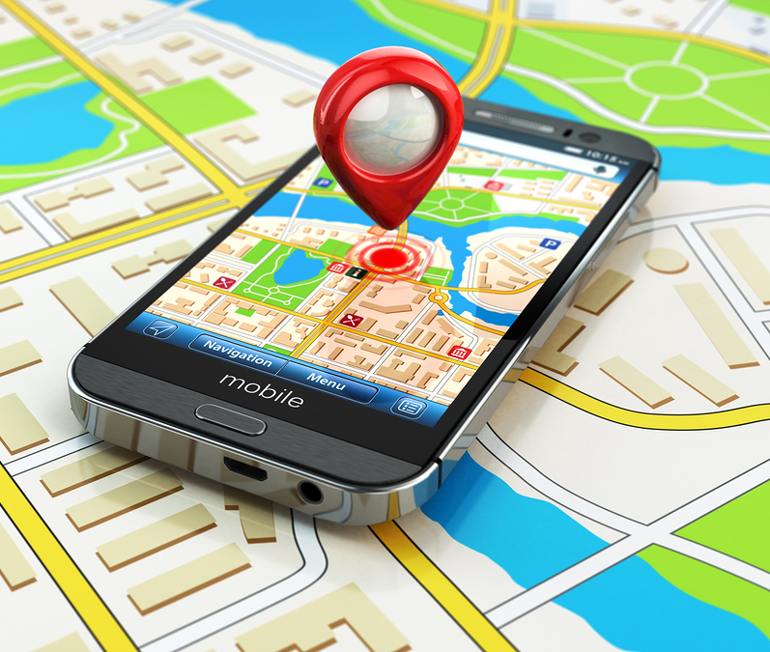
Application capabilities
Help
The data will help model a form entry tool that will be executed to automatically display the predictions.
Assist
The voice command & control feature will assist the visually impaired individuals have their information captured by the app.
GPS
The GPS functionality will help define locations where the current prevalence is and the next location predicted by the app

Slide 5
Application capabilities…
Our own configured server will work concurrently with the cloud-based hosting system. This will not only assist on an ever-available app, but also strengthen the security of the app and system at large.
The app will adhere to various ethical values and standards and safeguard the integrity of the participants personal details by not displaying them.
The app will also be able to display the signs and symptoms related to Covid-19 whenever one logs into it.

Slide 6
Private transport businesses.
All local restaurants..
Health care investors.
World Health Organization (WHO).
USA Government – Health Department.
Various Development Partners including International NGOs.
Data Sources
WorldoMeter
https://www.worldometers.info/coronavirus/
WHO data
App development.
Direct sales/marketing to government and WHO.
Advertisement on media platforms.
Linkages with other partners.
Web/Desktop application.
Regular notifications.
View the app through voice control.
Unlimited access to updated data.
No commercials.
Various trackers/dashboards.
Self service.
On demand and regular meetings with identified customer based organization like the health department.
Ease of use.
Our partners are our customers too.
We shall deploy the product in phases and consider customer’s opinion during development and would continuously improve the application by integrating with other pain areas across the world.
Cloud secured platform.
Employees.
Python/Java SDK Platform.
Windows Server 2020.
Cloud Based Hosting Services Company..
Word of mouth.
Any device.
Use of all the available media platforms for marketing.
One on one engagement with prospective customers
Research and Devolopment.
Marketing
Licensing.
Subscription business model that also offers free options.
Future Model - licensing the health related data and content.
College Project
Team 14
Covid-19 Predictor (CP)

Slide 7
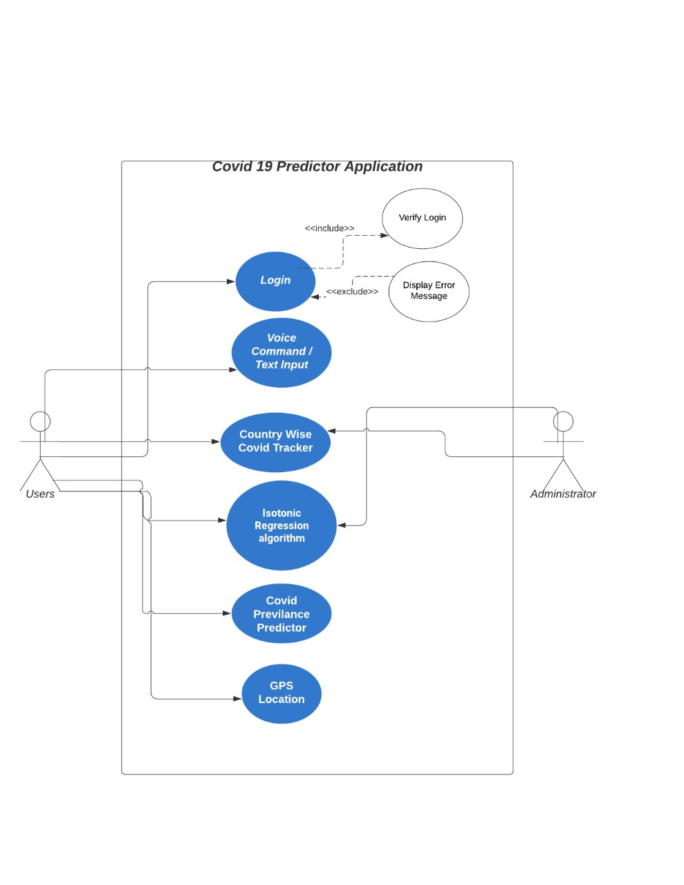
WORKFLOW

Slide 8
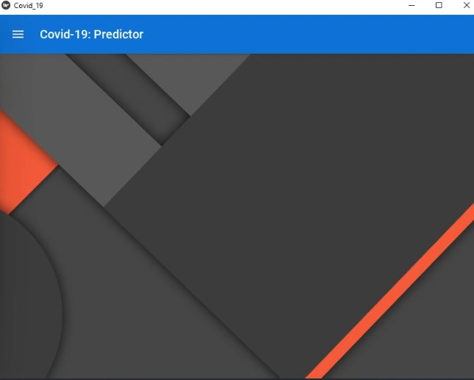
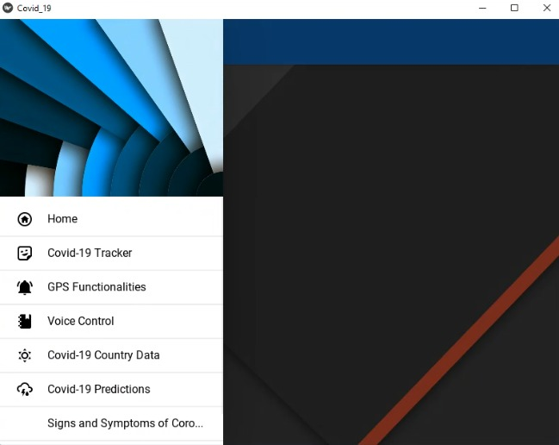
Front end UI for end user

Slide 9
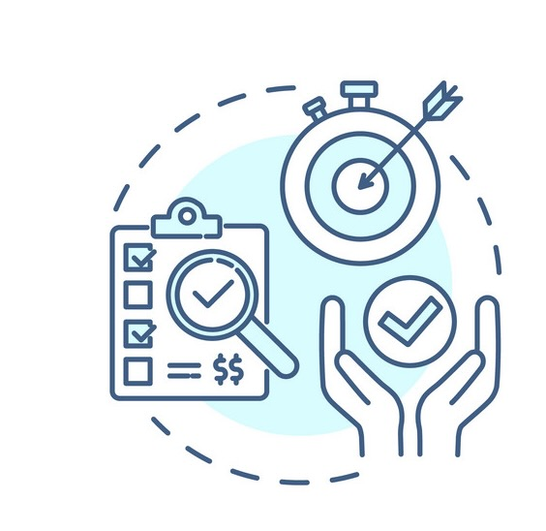
Justification
This app can be used by all groups of people. The covid-19 predictor is expected to be of suffice to all groups of people since coronavirus does not choose on whom to infect.
The app shall be able to submit its information to various authorized agencies within the health ministry irrespective of the user.
An all-time available connectivity, therefore, the app can be found and used at any time.

Slide 10
Conclusion & Plan for implementation
This section outlined some of the building block features of the app. We have also elaborated on the app capabilities and justified why this app is important.
Going forward, we shall implement the development of this app on Python SDK platform
We shall also define the hosting organizations, both cloud services and health department agencies.
We shall also do a pilot testing for the prototype and the complete developed app

Slide 11


